Slide 1
Good morning! While we wait to begin…
Connect to WIFI:
Network: MSFTGuest
Event Code: mseventXXXXX
If you have trouble getting to the connection page, try: www.msftconnecttest.com/redirect
Ensure your subscription is setup using the pass provided.
Ensure you have Visual Studio or VS Code installed.

Slide 2
Azure DevOps Workshop
Oct 29 – 30, Tampa FL
Stephen T. Mann
Cloud Solution Architect

Slide 3
AGENDA
Plan
Boards
Develop
Branching
Repos
GitHub
Test
Unit testing
Test plans
Deploy
CI
CD
Monitor
Insights
Limits
What is DevOps?
Artifacts

Slide 4
Azure DevOps: Introduction

Slide 5
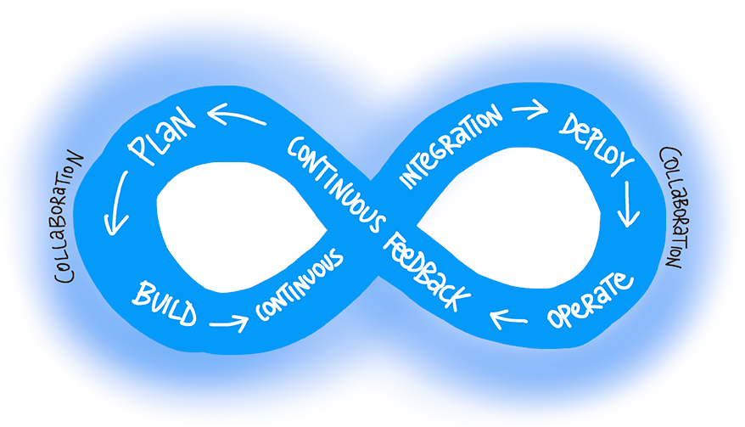
What is “DevOps”?
“DevOps is the union of people, process, and products to enable continuous delivery of value to our end users.” - Sam Guckenheimer
Joining Development and Operations
Multidisciplinary teams that now work together with shared and efficient practices and tools.
Essential DevOps practices
Agile planning
Continuous integration
Continuous delivery
Monitoring of applications
DevOps Learning Resources:
https://aka.ms/devops

Slide 6

Why DevOps?
Scale
78k+ engineers @ MSFT
Speed
Builds took 19hrs, goal <5min
Rapid Deployment
42k deployments per day
Release early, release often, fail fast
Martin Woodward
Principle Program Manger

Slide 7
How Microsoft does DevOps.
Changing The Definition Of Done
Live in production
Collecting telemetry that examines the reason for the deployment
Agile principals in practice
Moving to cloud cadence
One Engineering System - (1ES)
Live-Site Culture (or a Production-First Mindset)
Branching
Release Flow
Trunk based branching https://trunkbaseddevelopment.com/
Testing
Continuous improvement, not continuous fire drills
Sustainability
Focus on Customer obsession, building value

Slide 8

Azure DevOps
Azure DevOps Services
Cloud-based
Scalable
Reliable, 99.9% SLA
Monitored
Azure DevOps Server
On-premises/Self-hosted
Built on a SQL Server back end
Azure DevOps Services -vs- Azure DevOps Server
Simplified server management.
Immediate access to the latest and greatest features
Improved connectivity with remote sites.
A transition from capital expenditures (servers and the like) to operational expenditures (subscriptions).

Slide 9
Azure Boards: Agile Project Management

Slide 10
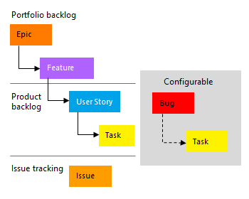
Azure Boards: Agile Project Management
Track work
Kanban boards provide easy, visual swim lanes to mange active work
Backlogs enable teams and project managers to plan, prioritize, and commit future features and track open issues

Slide 11
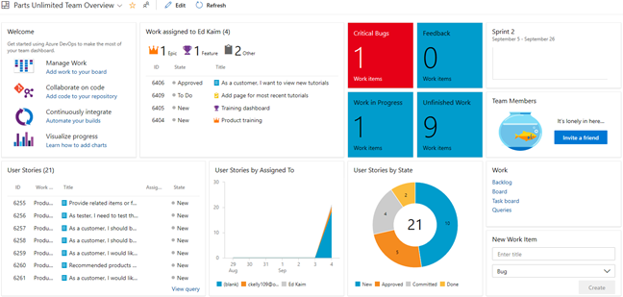
Agile Board: Management Dashboards
Visualize
Bugs
WIP
Assignment
Item State
Test State
Quick Access
New Items

Slide 12
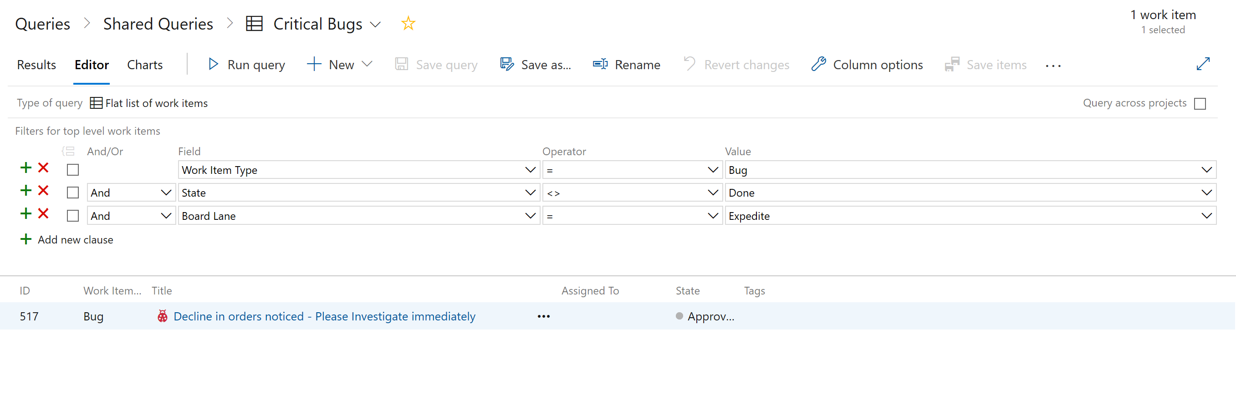
Agile Board: Custom Queries
Create custom queries to identify important areas of the backlog.
Visualize query results with graphs and charts.

Slide 13
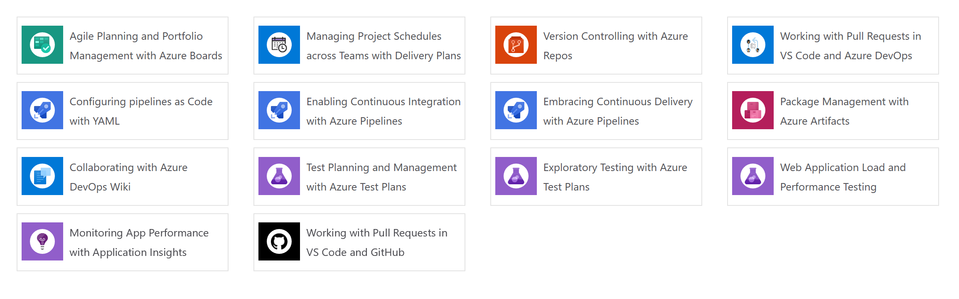
Exercise 1
Go to Agile Planning and Portfolio Management with Agile Boards
https://www.azuredevopslabs.com/labs/azuredevops/agile
Complete Exercise 1, Tasks 1-5 only.

Slide 14
Code Management: Branching & Policies

Slide 15
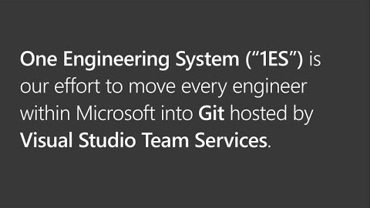
Azure Repos: Branching & Policies
Now that we understand the basics of code management, we need to implement a branching strategy.
We also want to protect our existing code from bugs as much as possible; so to ensure a minimum of standards are adhered to, we will enforce branch policies when a pull request is submitted.
Edward Thomson
Git Community program manager for Azure DevOps

Slide 16
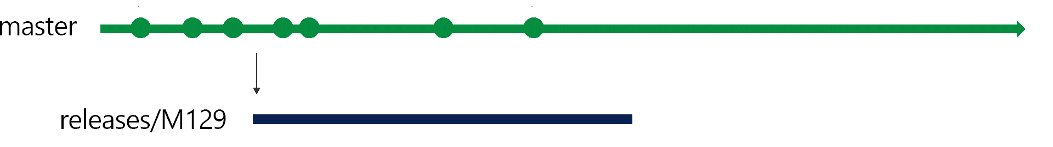
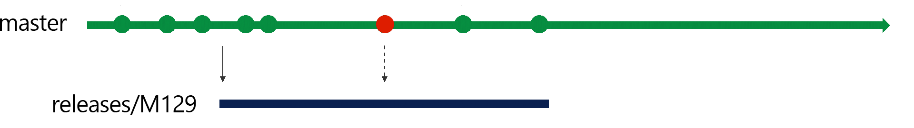
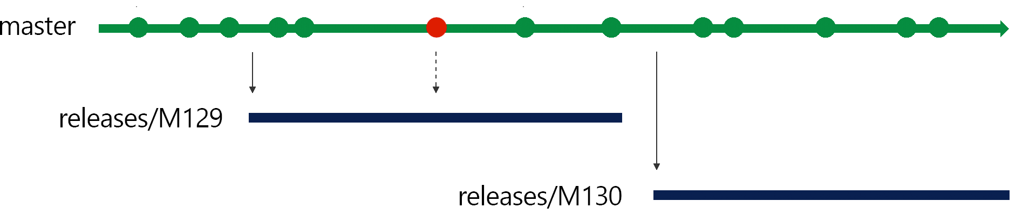
Azure Repos: Microsoft’s Branching Strategy
Release Flow
We continue developing in our master branch and batch up deployments into three week blocks, aligned with our sprint cadence.
At the end of a sprint, we create a deployment branch from the master branch: for example, at the end of sprint 129, we create a new branch releases/M129. We then put the sprint 129 branch into production.
After three weeks, we'll finish adding features to sprint 130, and we'll be ready to deploy those changes. To deploy, we'll create the new release branch, releases/M130 from master, and deploy that.

Slide 17
Azure Repos: Introduction

Slide 18
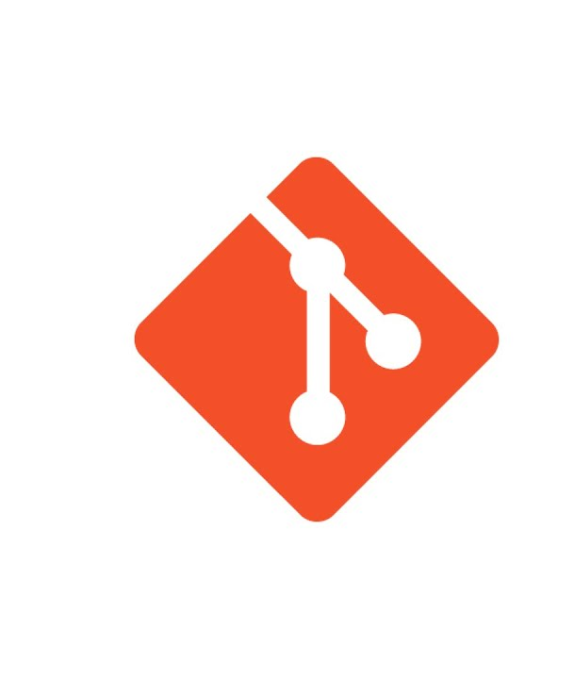

Azure Repos: Introduction
Version Control
Enables team collaboration
Safeguards your IP
Azure Repos support Git or TFVC version control systems
Microsoft recommends Git
Git is the most commonly used version control system today and is quickly becoming the standard for version control.

Slide 19
Azure Repos: Code Management
Branch
Consists of a main integration branch, master and short-lived "topic" branches for new features.
Developers are encouraged to commit early and to avoid long-running topic branches.
Push
When the developer is ready to get their changes integrated and ship their changes to the rest of the team, they push their local branch to a branch on the server and open a pull request.
Pull Request
We use Azure DevOps Pull Requests to control how developer's topic branches are merged into master.
Pull Requests ensure that branch policies are satisfied.
Merge
Once all the build policies are satisfied and reviewers have signed off, then the pull request is completed. This means that the topic branch is merged into the main integration branch, master.

Slide 20
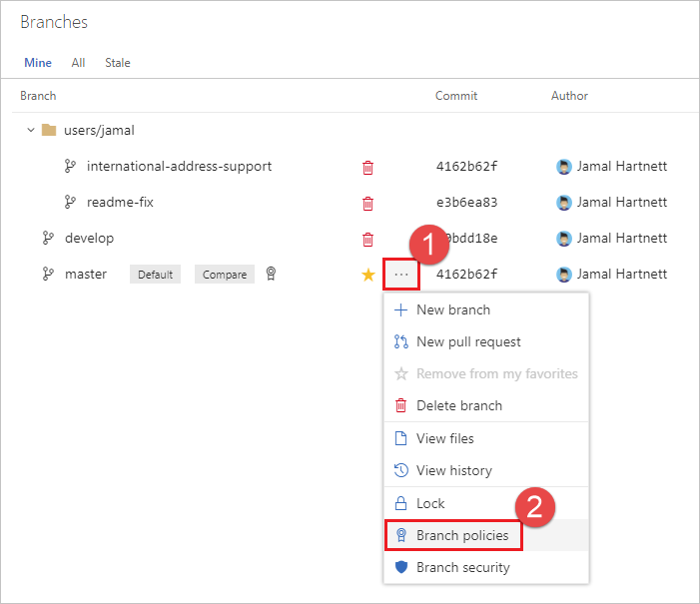
Azure Repos: Protecting Branch Integrity with Policies
Branch policies are an important part of the Git workflow and enable you to:
Isolate work in progress from the completed work in your master branch
Guarantee changes build before they get to master
Limit who can contribute to specific branches
Enforce who can create branches and the naming guidelines for the branches
Automatically include the right reviewers for every code change
Enforce best practices with required code reviewers

Slide 21
Exercise 2
Go to http://dev.azure.com
Follow instructor directions.

Slide 22
GitHub: Introduction

Slide 23
The #1 developer platform on the planet
33M+ Developers on GitHub
100M Private and public repositories
1B+ Contributions per year
2M Organizations and growing
Notes:
And, we see the evidence of this in many different ways.
GitHub is the #1 developer platform on the planet with over 31M developers and growing on our platform.
GitHub is also the largest code repository in the world with over 100M repositories hosted.
In 2018, open source developers made more than 1.1 billion updates to 96 million repositories on GitHub.
GitHub’s dominance in open source is the result of their intense focus on developers.
GitHub has long been known as the home of the largest open source community in the world and it continues to grow.
GitHub allows hundreds, even thousands, of developers to contribute to the same code base without fear of losing or overwriting work.
After seeing the successful projects being built in the open source communities, organization of all shapes and sizes took notice.
Today, GitHub is meeting the demands of some of the most challenging business environments, including highly regulated industries from automotive and finance, to farming and medicine.

Slide 24


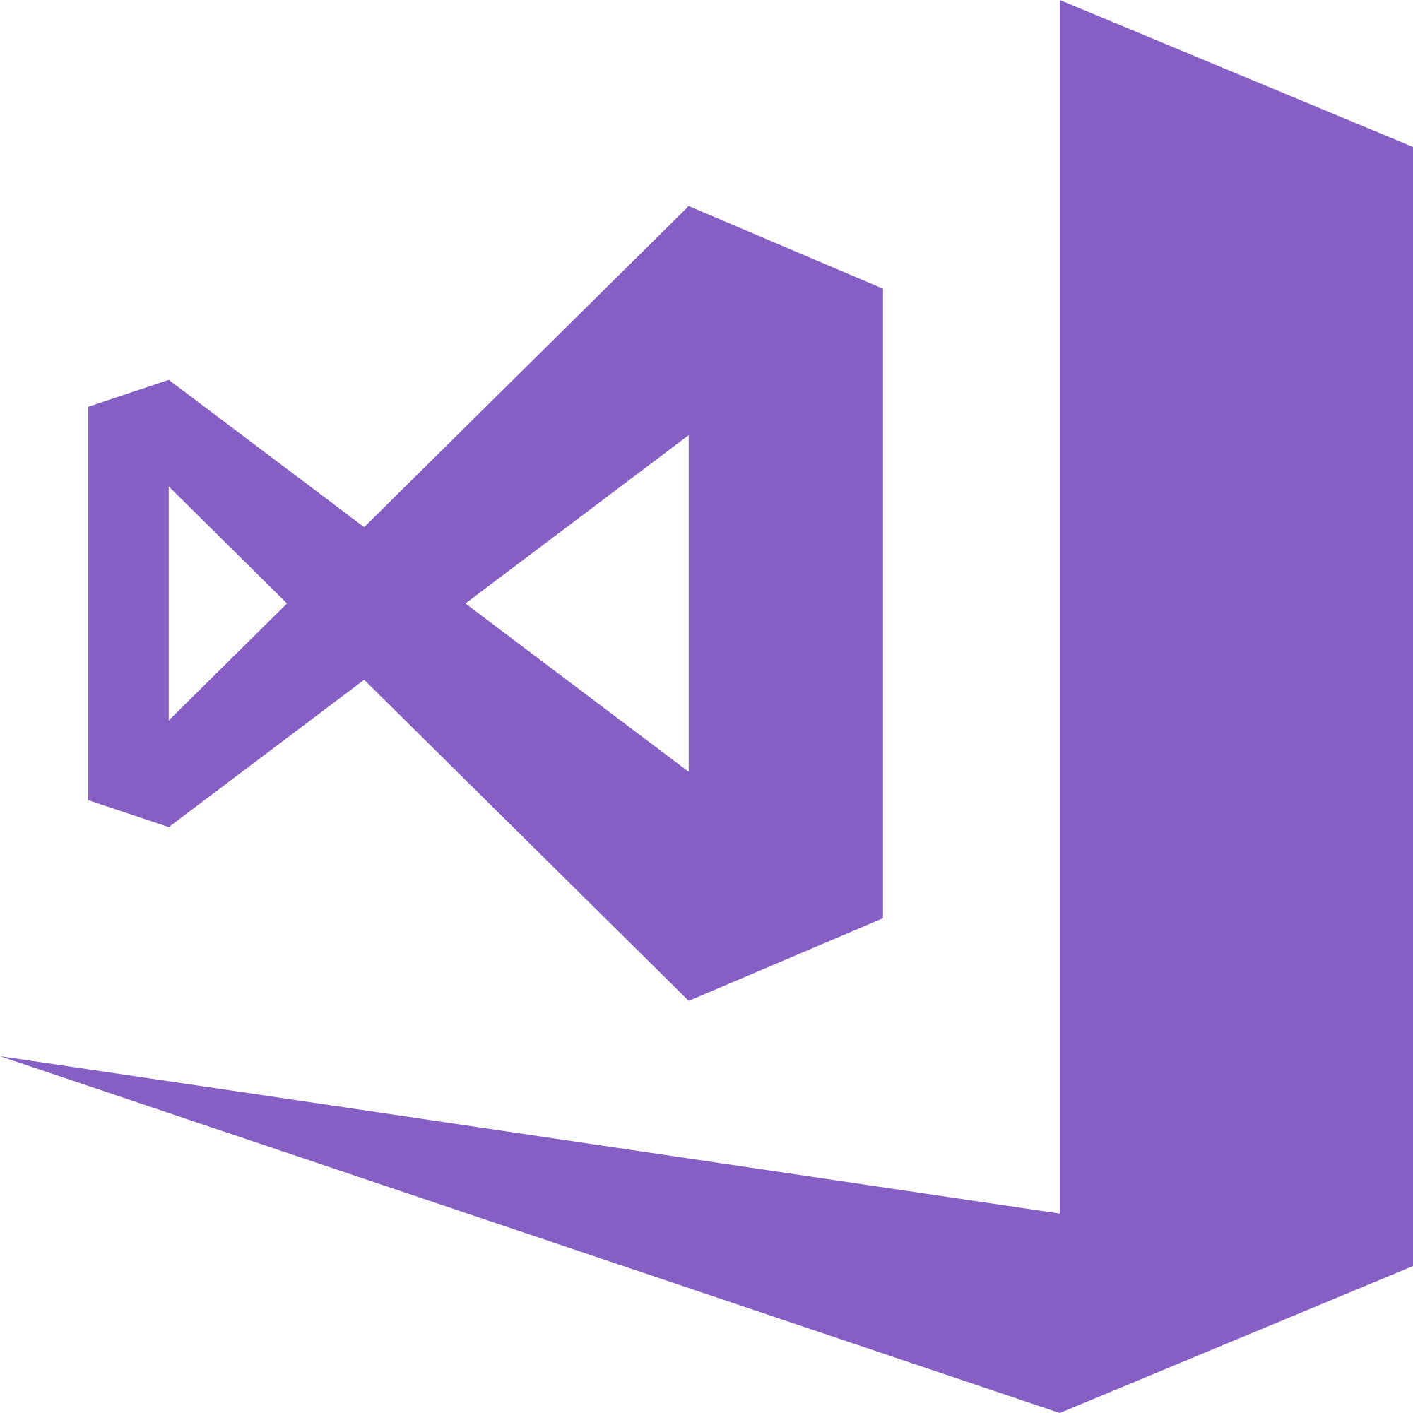




Use the best of breed DevOps tools
Use the best of breed DevOps tools with Azure DevOps and collaborate on GitHub
Plan
Develop
Collaborate
Deliver
Operate
Boards
(Azure DevOps)
Visual Studio
Visual Studio Code
GitHub
Pipelines + Test Plans & Artifacts
(Azure DevOps)
Monitor
(Azure Monitor)
Faster delivery to production = More business value
Notes:
So, we’ve just run through our overall solution and how this addresses all five areas that enable you to innovate at scale, and deliver with confidence. We looked at how you can use:
Azure Boards to Plan
Visual Studio and Visual Studio Code to maximize developer efficiency
GitHub to accelerate collaboration and open source development practices
Azure DevOps; Pipelines, Test Plans and Artifacts to accelerate delivery of your products and
Azure Security & Management services to ensure your products operate reliably, scale and remain secure

Slide 25

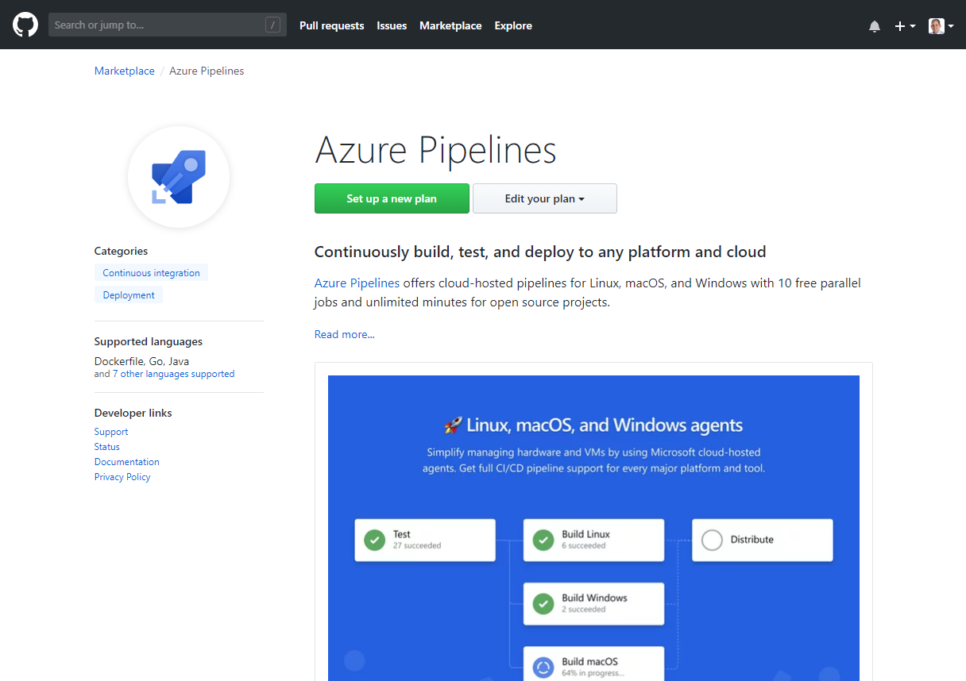
Fully integrated to maximize developer velocity
Connect to your GitHub repositories in Visual Studio
Link your GitHub commits
with Azure Boards
Continuously build, test, deploy to any platform or cloud with Azure Pipelines

Slide 26
Access the full breadth of the Azure Platform
Plan
Develop
Core Infrastructure
Advanced Workloads
Compute
Web + Mobile
Security
Internet of Things
Storage
Microservices
Management
Containers
Collaborate
Serverless
Collaborate
Networking
Identity
Operate
Deliver
Data + Analytics
Ansible
Chef
ELK Stack
Grafana
Puppet
Jenkins
Maven
Packer
Terraform
Artificial Intelligence
Operate
Deliver
Cognitive Services
High Performance
Computing
Azure Stack + Hybrid
Notes:
Not only do you get the most productive Developer and DevOps tools and platforms with GitHub and Microsoft Azure
But, because these are integrated with Microsoft Azure, you can deploy to and take advantage of our 140+ services that we have for your use
This is not a complete listing of all the of the services, but highlights some of the key/main areas that you can utilize to accelerate your innovation
You can deploy to our core infrastructure, or advanced platform as service workloads such as Azure Functions and Azure Kubernetes service
As well as leverage Microsoft and open source data solutions, AI and cognitive services
As well as extending your applications across Azure Stack and Hybrid deployments

Slide 27
Enterprises choose GitHub for modern software development
Largest community of developers and open source to find talent, learn best practices, and reuse code
Largest ecosystem of developer tools to create the best workflow for your teams
AI-powered security alerts to accelerate secure code development
Enterprise-grade platform for performance, reliability, and support
Collaboration
Security
Community
Platform
Ecosystem
Notes:
Modern software development is more than Agile and DevOps, it is about changing the way that your development teams communicate and collaborate to create better software faster.
If you want to do more than simply refactor your applications to run on cloud resources, you need to change the way that you work.
You need to be more collaborative, shift development activities closer to business outcomes, streamline your workflows, and give the developers more power to affect change.
Second, you need to leverage the open source communities.
Not just for the code that they create that will help you assemble apps and ship faster, but also for data and insights, and the best practices that help you work faster.
Taking these principles and applying them to your own organization will help you learn to leverage your own code more effectively, and ship change faster.
And of course it needs to include Security and Trust.
Security needs to be part of the process from the start.
As software vulnerabilities have tripled in the last three years alone (source: NIST NVDB) you need to design for security, scan frequently, and remediate quickly.
A software vulnerability is like a bug—the earlier you catch it, the cheaper it is to fix.
You also need to trust your tools or services to be secure. The last thing you need is to have your data leaked because your tool or service wasn’t doing its job.

Slide 28
Exercise 3
Go to Version Controlling with Azure Repos
https://www.azuredevopslabs.com/labs/azuredevops/git/

Slide 29
Microsoft’s QA Journey

Slide 30
QA @ MSFT pre-2000
PMs owned understanding customer requirements and writing feature specs
Devs owned designing and coding the features.
Testers owned testing the features.
Teams had a ratio of 1 dev to 1 test to 0.5 PM, with some variance among teams.
The test discipline had two separate roles: Software Design Engineer Test (SDETs) who developed the automation, the test infrastructure etc., and then Software Test Engineer (STEs) who ran the automation or who ran manual tests.

Slide 31
QA @ MSFT post-2000: Transformation 1
Software Design Engineer Test (SDETs) and Software Test Engineer (STEs) merge.
A companywide decision was made to get rid of the STE roles and make SDETs accountable for not only developing tests but also running and maintaining automation.
This improved the model. It improved accountability and incentive on SDETs to write better and more automation. But the core problem remained. The SDETs couldn’t keep up with the code thrown over the wall.

Slide 32
QA @ MSFT mid-2000: Cloud Cadence
Transformation 2
Shifting our quality priorities.
We pushed testing left, we pushed testing right and got rid of most of the testing in the middle. This is a departure from the past where most of the testing that was happening in the middle – integration style testing in the lab.
Shifting QA left = Testing early and often.
Shifting acceptance/user testing right = Production is a test ground.

Slide 33
Code Quality in a Cloud Cadence
How did our approach to Quality change in the Cloud cadence? We did three big things.
We redefined quality ownership, we fixed the accountability.
We understood that in order to ship frequently, Master branch must always remain as healthy as the release branch. We defined a core principle – Master is always shippable. The principle touches everything – source code management, code practices, build etc. From testing perspective, we pushed two things: shift-left testing (i.e. greater emphasis on unit testing) and eliminating flaky tests.
We also understood there is no place like production. This is the shift-right part of the strategy. It’s a set of practices about both safeguarding the production as well as ensuring quality in production.

Slide 34
Anatomy of Automated Testing
Test Taxonomy
We needed new taxonomy. Previous taxonomy was based on duration of the tests, nightly run (NAR), full automation run (FAR), etc. We created new taxonomy that was based on the measure of external dependencies. We roughly divided tests into two categories: Unit Test and Functional Tests
L0/L1 – Unit tests
L0 – Broad class of fast in-memory unit tests. An L0 test is a unit test to most people. That is a test that depends on code in the assembly under test and nothing else. <60ms execution.
L1 – A L1 test might require the assembly plus SQL or the file system. ~<400ms execution, not >2s.
L2/L3 – Functional tests
L2 – Functional tests run against “testable” service deployment. It is a functional test category that requires a service deployment but may have key service dependencies stubbed out in some way.
L3 – This is a restricted class of integration tests that run against production. They require a full product deployment.

Slide 35
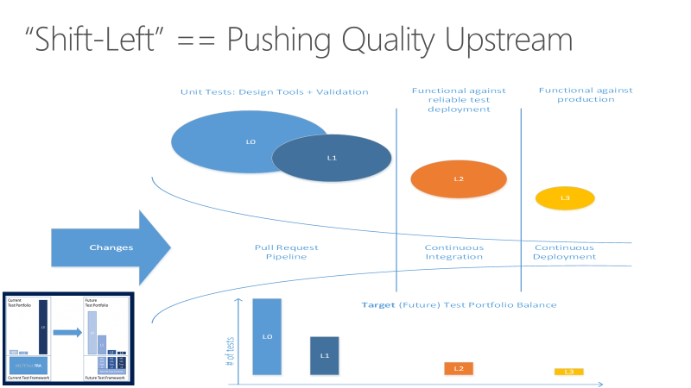
Shifting left with automation

Slide 36
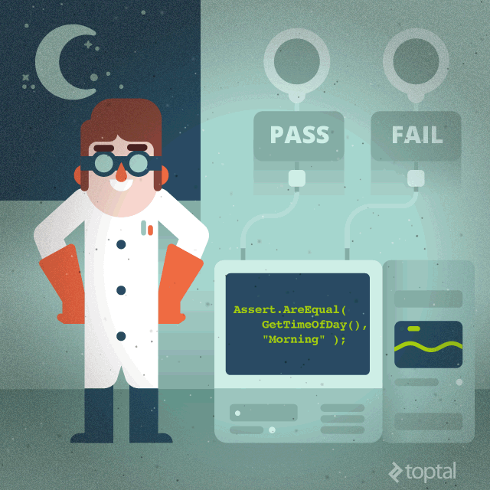
What makes a good automated test?
Easy to write
Test should be smaller, simpler
More tests are better than more complex tests
Readable
A tests intent should be clear from a simple glance
Reliable
Should only fail when it is supposed to
Fast!
Many tests add up
Slow tests get tend to be skipped
Truly unit, not integration
Credit: Sergey Kolodiy - https://www.toptal.com/qa/how-to-write-testable-code-and-why-it-matters

Slide 37
Demo
Functional Test Automation E2E Creation
Notes:
https://www.azuredevopslabs.com/labs/vstsextend/selenium/

Slide 38
Azure Test Plans: Manage Manual Testing

Slide 39
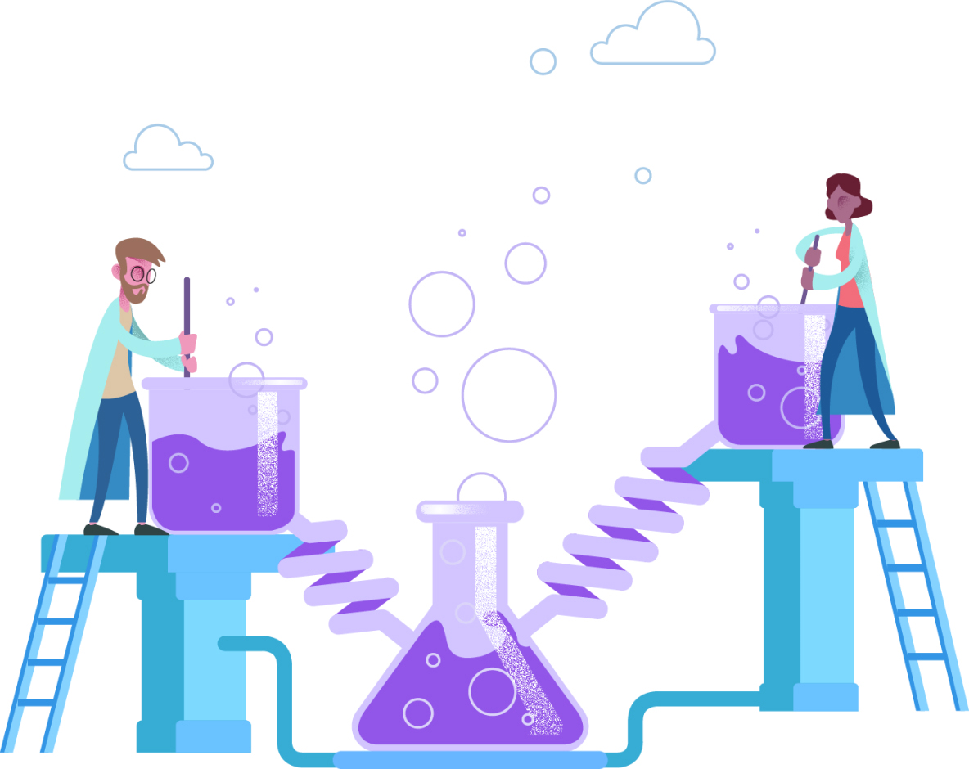
Azure Test Plans: Manual Testing
Test Planning and Management
Exploratory Testing
Load and Performance Testing

Slide 40
Exercise 4
Go to Test Planning and Management with Azure Test Plans
https://www.azuredevopslabs.com/labs/azuredevops/testmanagement/

Slide 41
End of Day 1

Slide 42
Azure Pipelines: Continuous Integration

Slide 43
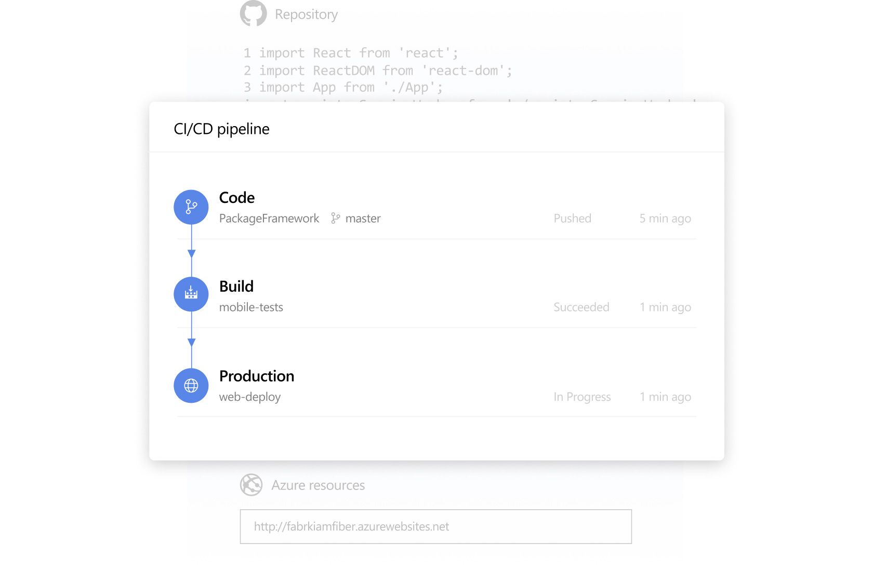
Continuous Integration
Continuous Integration (CI) is the process of automating the build and testing of code every time a team member commits changes to version control.
Teams use build definitions to ensure that every commit to the master branch triggers the automated build and testing processes. Implementing CI this way ensures bugs are caught earlier in the development cycle, which makes them less expensive to fix. Automated tests run for every build to ensure builds maintain a consistent quality.

Slide 44
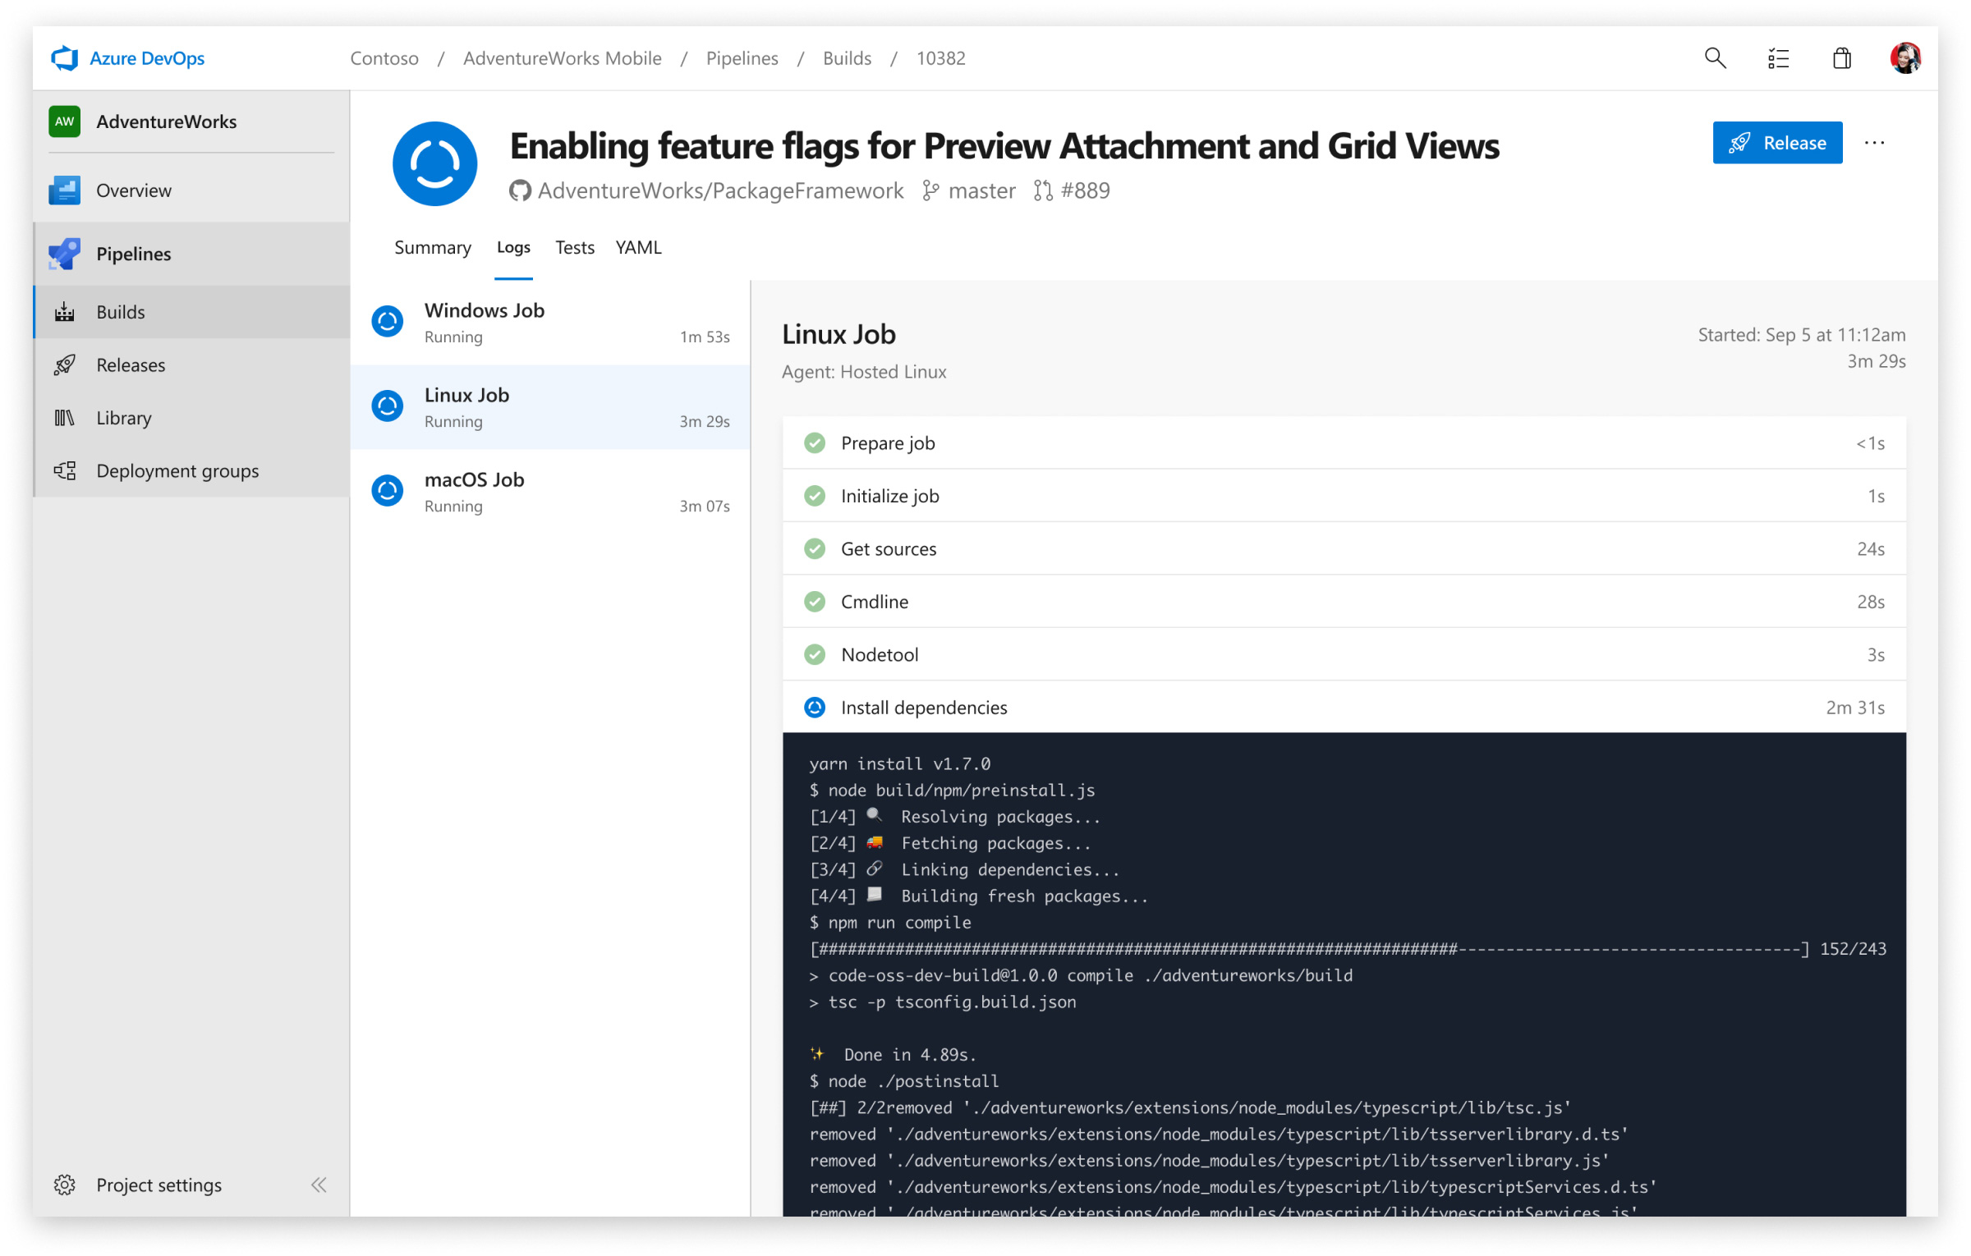
Azure Pipelines: Build Pipeline
Defining a Build Pipeline
YAML vs Classic
Enabling CI
YAML CI Configuration

Slide 45
Exercise 5
Go to Enabling Continuous Integration with Azure Pipelines
https://www.azuredevopslabs.com/labs/azuredevops/continuousintegration
Complete Exercise 1.

Slide 46
Azure Pipelines: Continuous Delivery
Notes:
Show of hands, how many of you have used an Azure release pipeline?
Of those, how many of you believe that you need a separate pipeline for each distinct environment?

Slide 47
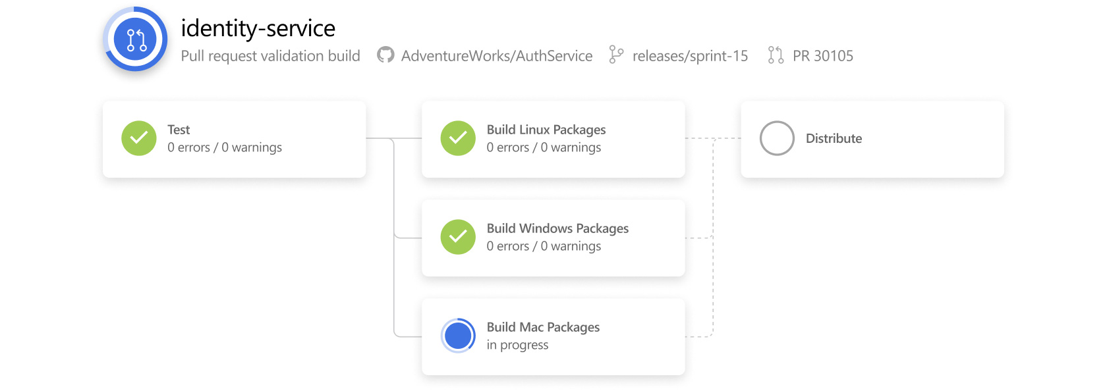
Azure Pipelines: Continuous Delivery
Continuous Delivery (CD) is the process to build, test, configure and deploy from a build to a production environment. Multiple testing or staging environments create a Release Pipeline to automate the creation of infrastructure and deployment of a new. Successive environments support progressively longer-running activities of integration, load, and user acceptance testing.
Continuous Delivery may sequence multiple deployment “rings” for progressive exposure (also known as “controlling the blast radius”).
Continuous Delivery is a lean practice. The goal of CD is to keep production fresh by achieving the shortest path from the availability of new code in version control or new components in package management to deployment.

Slide 48
Exercise 6
Go to Embracing Continuous Delivery with Azure Pipelines
Do this first: https://aka.ms/PartsUnlimitedArm
Then: https://www.azuredevopslabs.com/labs/azuredevops/continuousdeployment
Notes:
After completing lab, cover gate controls.

Slide 49
Azure Pipelines: Continuous Delivery Part 2

Slide 50
Azure Pipelines: Continuous Delivery Part 2
Previously we delivered our product by creating a release pipeline that used Azure Resource Manager (ARM). We can also use Terraform to release our product to Azure.
Some notable take-aways when using Terraform:
By default, Terraform stores state locally in a file named terraform.tfstate. When working with Terraform in a team, use of a local file makes Terraform usage complicated. With remote state, Terraform writes the state data to a remote data store. We are going to use an Azure CLI task to create Azure storage account and storage container to store Terraform state.
The Terraform extension will need to be installed in the DevOps organization.

Slide 51
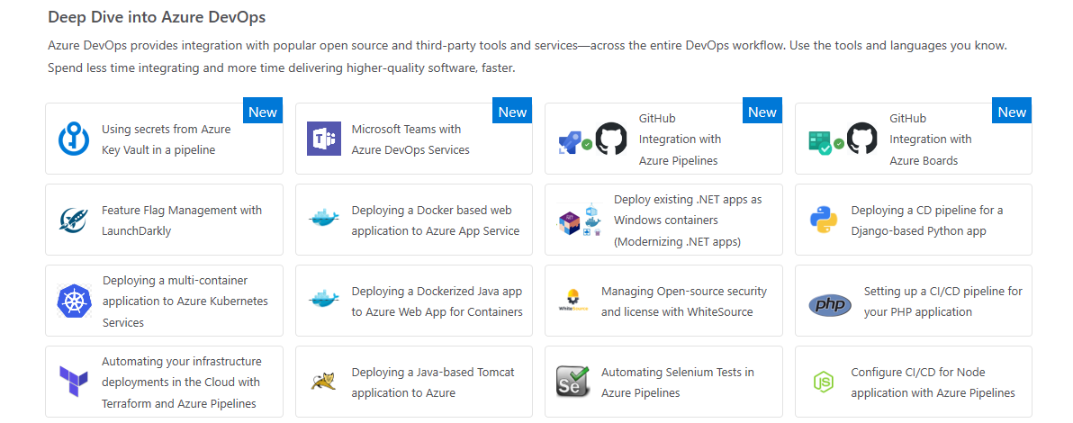
Exercise 7
Go to Automating your infrastructure deployments in the Cloud with Terraform and Azure Pipelines
https://www.azuredevopslabs.com/labs/vstsextend/terraform

Slide 52
Azure Artifacts
Notes:
https://docs.microsoft.com/en-us/azure/devops/artifacts/?view=azure-devops

Slide 53

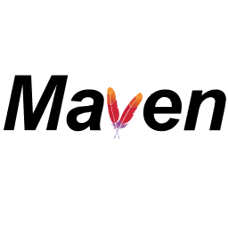
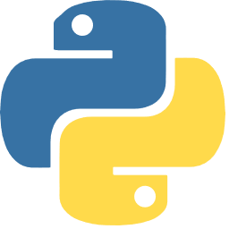
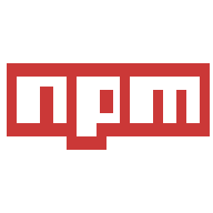
Azure Artifact: Enterprise Package Management
Multiple feeds to organize and control access to your packages.
Support for NuGet, npm, and Maven.
Key concepts:
Immutability
Recycle Bin

Slide 54
Azure Artifact features and their Compatablility
Feature | Azure DevOps Services | TFS
NuGet | Yes | TFS 2017 and newer
npm | Yes | TFS 2017 Update 1 and newer
NuGet.org upstream source | Yes | TFS 2018 Update 2 and newer
Maven | Yes | TFS 2018 and newer
Maven Central upstream source | Yes | No
Python | Yes | No
Universal Packages | Yes | No

Slide 55
Exercise 8
Go to Package Management with Azure Artifacts
https://azuredevopslabs.com/labs/azuredevops/packagemanagement/

Slide 56
Azure Monitoring: Application Insights

Slide 57

Azure Monitoring: Application Insights
Monitoring provides feedback from production and delivers information about an application’s performance and usage patterns. One goal of monitoring is to achieve high availability by minimizing time to detect and time to mitigate (TTD, TTM). A second goal of monitoring is to enable “validated learning” by tracking usage. “Telemetry” is the mechanism for collecting data from monitoring.
Application Insights is an extensible Application Performance Management (APM) service for web developers on multiple platforms. Use it to monitor your live web application. It will automatically detect performance anomalies.

Slide 58
Exercise 9
Go to Monitoring App Performance with Application Insights
https://www.azuredevopslabs.com/labs/azuredevops/appinsights/

Slide 59
Azure Limits

Slide 60
Common Azure Limitations
Resource | Default limit | Maximum limit
vCPUs per subscription | 20 | 10,000
Storage accounts per subscription | 100 | 100
VMs per subscription | 25,0001 per region. | 25,000 per region.
Resources per resource group, per resource type | 800 | Some resource types can exceed the 800 limit. See Resources not limited to 800 instances per resource group.
https://docs.microsoft.com/en-us/azure/azure-subscription-service-limits

Slide 61
End of Day 2

Slide 62
Resources
https://aka.ms/devops
https://azuredevopslabs.com
https://docs.microsoft.com/en-us/azure/devops/

